Slide 1

Retail
Integral
Design
Bowtielearning
Coffee Company
Marketing Plan

Slide 2



Requirements
Consumer Input
Competitors
Market

Slide 3
Competitive Landscape

Slide 4
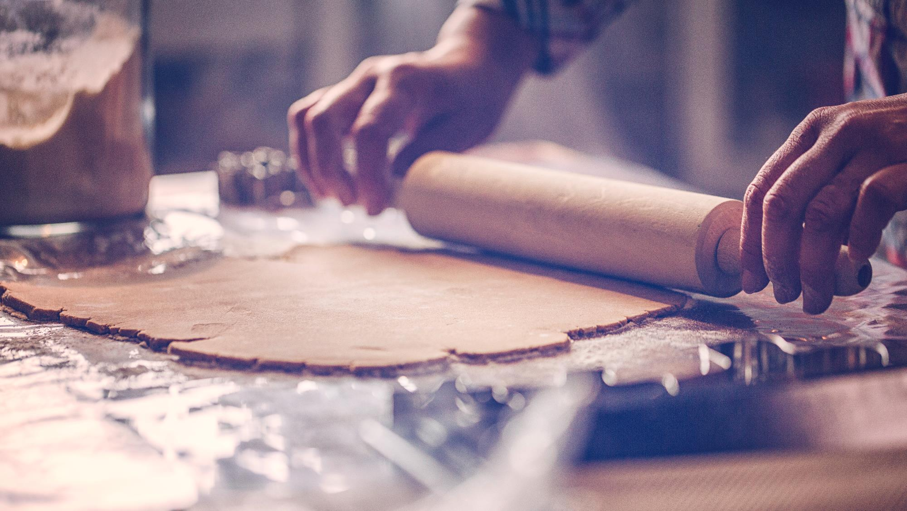

Key to Success
Better Sales
More Products
Quicker Responses
Better Service
Better Customers

Slide 5
Smaller Keys to Success
Better Sales
More Products
Quicker Responses
Better Service
Better Customers

Slide 6


Thanks for Listening!
Email
dave.murphy@bowtielearning.com

